Slide 1
Tips for Training Deep Neural Networks

Slide 2
Outline
Deep Neural Network
Parameters vs Hyperparameters
How to set network parameters
Bias / Variance Trade-off
Regularization Strategies
Batch normalization
Vanishing / Exploding gradients
Gradient Descent
Mini-batch Gradient Descent
Adarad

Slide 3

Deep Neural Network
……
y₁
W¹
W²
W^{L}
y₂
……
b^{L}
b¹
b²
……
……
……
……
……
x
a¹
a²
y
……
y_{M}
W¹
x
b¹
+
$$σ\left( \right)$$
W²
a¹
b²
+
$$σ\left( \right)$$
W^{L}
b^{L}
a^{L-1}
+
$$σ\left( \right)$$
Notes:
Draw it?

Slide 4
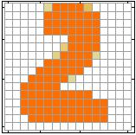

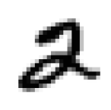
Deep Neural Network
$$θ=\left\{W^{1},b^{1},W^{2},b^{2},⋯W^{L},b^{L}\right\}$$
……
y₁
is 1
0.1
……
y₂
0.7
is 2
……
……
……
……
……
y₁₀
is 0
0.2
16 x 16 = 256
Ink → 1
No ink → 0
Set the network parameters $θ$ such that ……
Input:
How to let the neural network achieve this
y₁ has the maximum value
Input:
y₂ has the maximum value
By learning the network parameters 𝜃

Slide 5
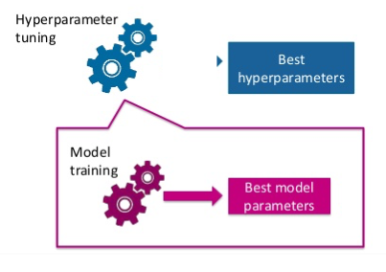
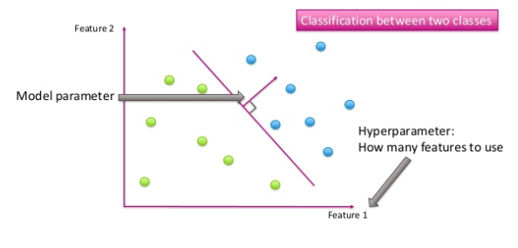
Parameters vs Hyperparameters
A model parameter is a variable of the selected model which can be estimated by fitting the given data to the model.
Hyperparameter is a parameter from a prior distribution; it captures the prior belief before data is observed.
These are the parameters that control the model parameters
In any machine learning algorithm, these parameters need to be initialized before training a model.
Image Source: https://www.slideshare.net/AliceZheng3/evaluating-machine-learning-models-a-beginners-guide

Slide 6
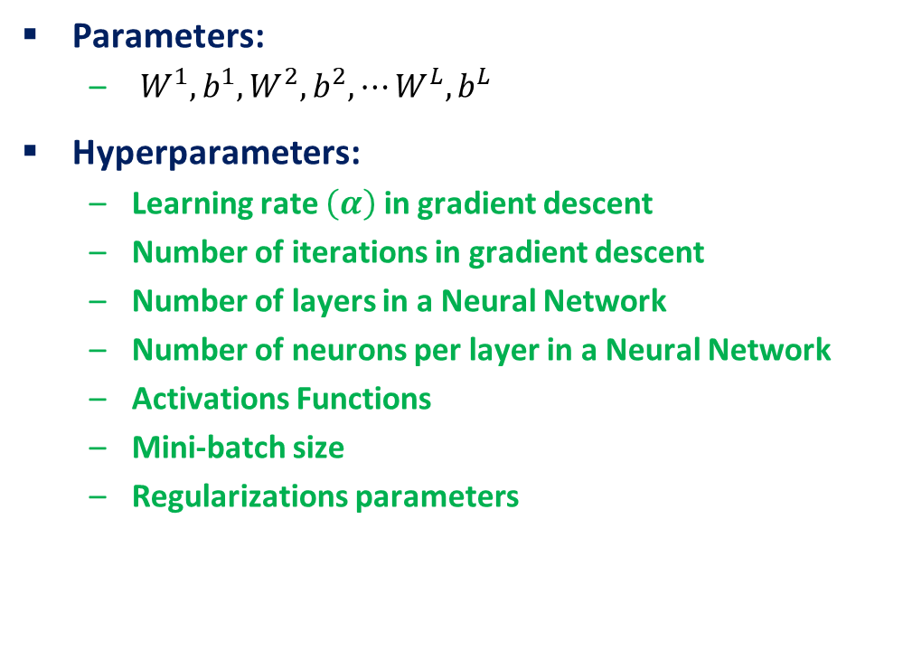
Deep Neural Network: Parameters vs Hyperparameters
Parameters:
$W^{1},b^{1},W^{2},b^{2},⋯W^{L},b^{L}$
Hyperparameters:
Learning rate $\left(α\right)$ in gradient descent
Number of iterations in gradient descent
Number of layers in a Neural Network
Number of neurons per layer in a Neural Network
Activations Functions
Mini-batch size
Regularizations parameters
Image Source: https://www.slideshare.net/AliceZheng3/evaluating-machine-learning-models-a-beginners-guide

Slide 7
Train / Dev / Test sets
Hyperparameters tuning is a highly iterative process, where you
start with an idea, i.e. start with a certain number of hidden layers, certain learning rate, etc.
try the idea by implementing it
experiment how well the idea has worked
refine the idea and iterate this process
Now how do we identify whether the idea is working? This is where the train / dev / test sets come into play.
Training Set
Dev Set
Test Set
We train the model on the training data.
Data
After training the model, we check how well it performs on the dev set.
When we have a final model, we evaluate it on the test set in order to get an unbiased estimate of how well our algorithm is doing.

Slide 8
Train / Dev / Test sets
Training Set (60%)
Dev Set (20%)
Test Set (20%)
Training Set (70%)
Test Set (20%)
Training Set (98%)
Dev Set (1%)
Test Set (1%)
Data
Previously, when we had small datasets, most often the distribution of different sets was
As the availability of data has increased in recent years, we can use a huge slice of it for training the model

Slide 9
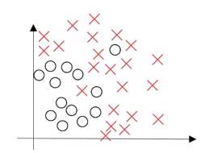
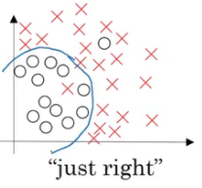
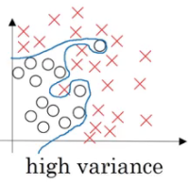
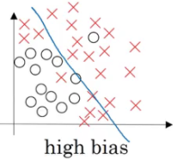
Bias / Variance Trade-off
Make sure the distribution of dev/test set is same as training set
Divide the training, dev and test sets in such a way that their distribution is similar
Skip the test set and validate the model using the dev set only
We want our model to be just right, which means having low bias and low variance.
Bias is the difference between the Predicted Value and the Expected Value.
Variance is the amount that the estimate of the target function will change, given different training data.
Image Source: https://www.analyticsvidhya.com/blog/2018/11/neural-networks-hyperparameter-tuning-regularization-deeplearning/

Slide 10
Bias / Variance Trade-off
Overfitting: If the dev set error is much more than the train set error, the model is overfitting and has a high variance
Underfitting: When both train and dev set errors are high, the model is underfitting and has a high bias
Image Source: https://www.analyticsvidhya.com/blog/2018/11/neural-networks-hyperparameter-tuning-regularization-deeplearning/

Slide 11
Overfitting in Deep Neural Nets
Deep neural networks contain multiple non-linear hidden layers
This makes them very expressive models that can learn very complicated relationships between their inputs and outputs.
In other words, model learns even the tiniest details present in the data.
But with limited training data, many of these complicated relationships will be the result of sampling noise
So they will exist in the training set but not in real test data even if it is drawn from the same distribution.
So after learning all the possible patterns it can find, the model tends to perform extremely well on the training set but fails to produce good results on the dev and test sets.

Slide 12
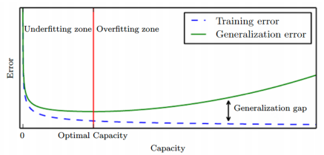
Regularization
Regularization is:
“any modification to a learning algorithm to reduce its generalization error but not its training error”
Reduce generalization error even at the expense of increasing training error
E.g., Limiting model capacity is a regularization method
Source: https://cedar.buffalo.edu/~srihari/CSE574/Chap5/Chap5.5-Regularization.pdf

Slide 13
Regularization Strategies

Slide 14
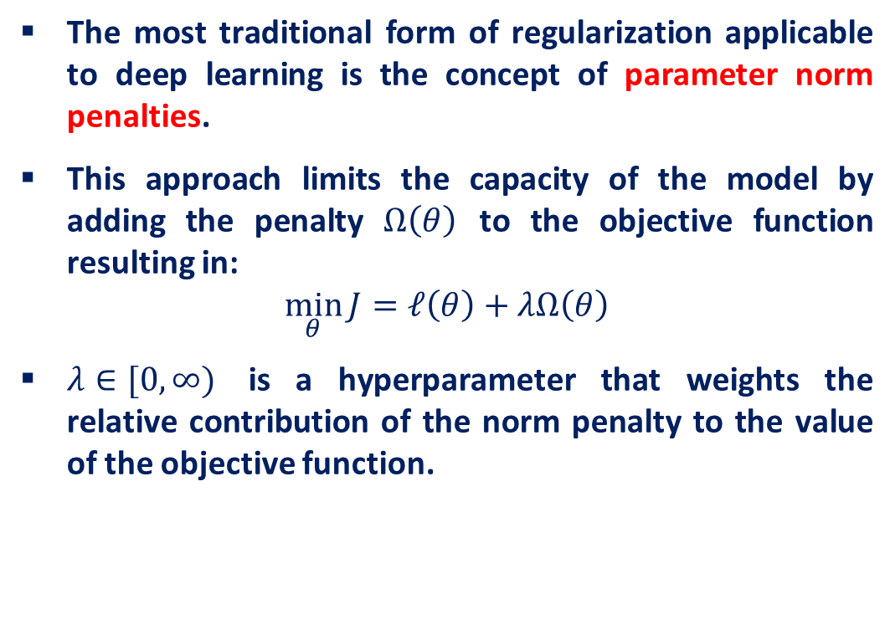
Parameter Norm Penalties
The most traditional form of regularization applicable to deep learning is the concept of parameter norm penalties.
This approach limits the capacity of the model by adding the penalty $Ω\left(θ\right)$ to the objective function resulting in:
$$\min_{θ}{J=ℓ\left(θ\right)+λΩ\left(θ\right)}$$
$λ∈[0, ∞)$ is a hyperparameter that weights the relative contribution of the norm penalty to the value of the objective function.

Slide 15
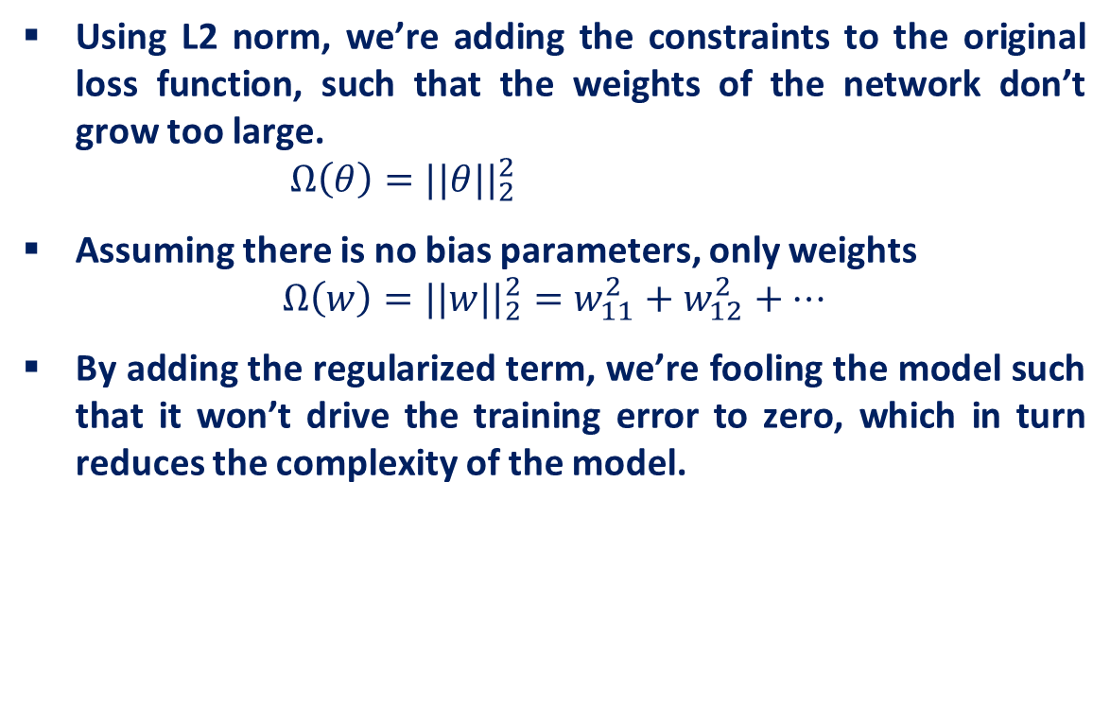
L2 Norm Parameter Regularization
Using L2 norm, we’re adding the constraints to the original loss function, such that the weights of the network don’t grow too large.
$$Ω\left(θ\right)=||θ||_{2}^{2}$$
Assuming there is no bias parameters, only weights
$$Ω\left(w\right)=||w||_{2}^{2}=w_{11}^{2}+w_{12}^{2}+…$$
By adding the regularized term, we’re fooling the model such that it won’t drive the training error to zero, which in turn reduces the complexity of the model.

Slide 16
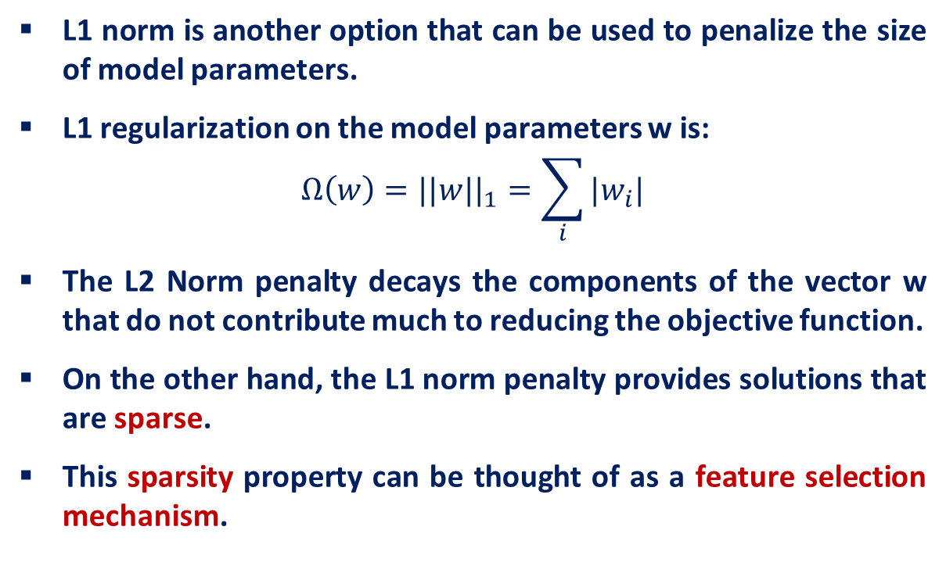
L1 Norm Parameter Regularization
L1 norm is another option that can be used to penalize the size of model parameters.
L1 regularization on the model parameters w is:
$$Ω\left(w\right)=||w||_{1}=\sum_{i}{|w_{i}|}$$
The L2 Norm penalty decays the components of the vector w that do not contribute much to reducing the objective function.
On the other hand, the L1 norm penalty provides solutions that are sparse.
This sparsity property can be thought of as a feature selection mechanism.

Slide 17
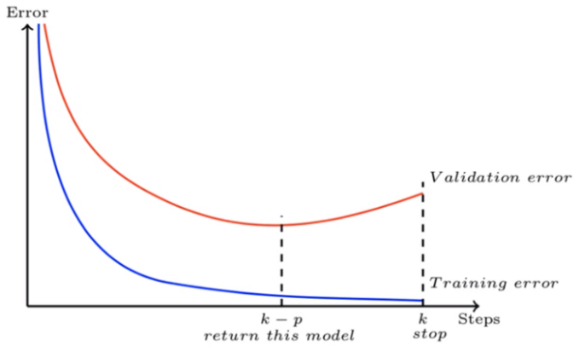
Early Stopping
When training models with sufficient representational capacity to overfit the task, we often observe that training error decreases steadily over time, while the error on the validation set begins to rise again or remaining the same for certain iterations, then there is no point in training the model further.
This means we can obtain a model with better validation set error (and thus, hopefully better test set error) by returning to the parameter setting at the point in time with the lowest validation set error

Slide 18
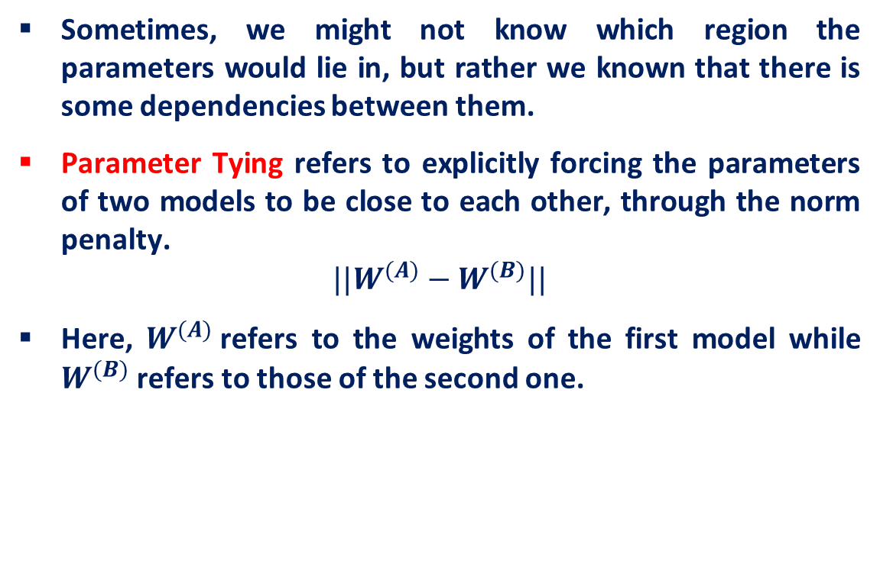
Parameter Tying
Sometimes, we might not know which region the parameters would lie in, but rather we known that there is some dependencies between them.
Parameter Tying refers to explicitly forcing the parameters of two models to be close to each other, through the norm penalty.
$$||W^{(A)}−W^{(B)}||$$
Here, $W^{(A)}$refers to the weights of the first model while $W^{(B)}$refers to those of the second one.

Slide 19
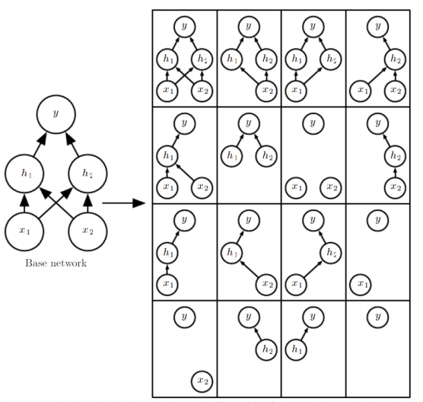
Dropout
Dropout is a bagging method
Bagging is a method of averaging over several models to improve generalization
Impractical to train many neural networks since it is expensive in time and memory
It is a method of bagging applied to neural networks
Dropout is an inexpensive but powerful method of regularizing a broad family of models
Specifically, dropout trains the ensemble consisting of sub-networks that can be formed by removing non-output units from an underlying base network.

Slide 20
Dropout - Intuitive Reason
When teams up, if everyone expect the partner will do the work, nothing will be done finally.
However, if you know your partner will dropout, you will do better.
When testing, no one dropout actually, so obtaining good results eventually.
Notes:
Why the weights should multiply p (dropout rate) at testing?

Slide 21
Dropout
Training:
Each neuron has p% to dropout
Notes:
Iteration v.s. epoch!!!!!!!!

Slide 22
Dropout
Training:
Thinner!
Each neuron has p% to dropout
The structure of the network is changed.
Using the new network for training
Notes:
Do not worry that someone will not update

Slide 23
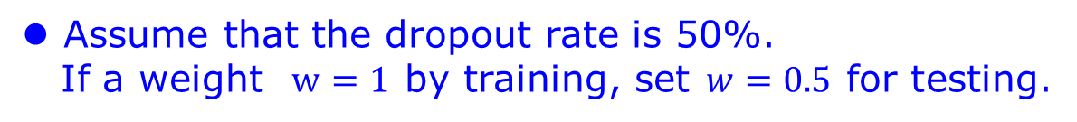
Dropout
Testing:
No dropout
If the dropout rate at training is p%, all the weights times (1-p)%
Assume that the dropout rate is 50%.
If a weight $w=1$ by training, set $w=0.5$ for testing.
Notes:
Bias do not have to multiply !!!!!!!!!!!!!!!!!!!!!!!!!!!!!!!!!!!
Reasonable !!!!!!!!!!!!!!!!!!!!

Slide 24

Why the weights should multiply (1-p)% (dropout rate) when testing?
x₁
x₂
w₁
w₂
x₁
x₂
x₁
x₂
w₁
w₂
w₁
w₂
z=w₁x₁+w₂x₂
z=w₁x₁+w₂x₂
z=w₂x₂
x₁
x₂
x₁
x₂
x₁
x₂
$$\frac{1}{2}$$
$$\frac{1}{2}$$
w₁
w₂
w₁
w₂
w₁
w₂
$$z=\frac{1}{2}w_{1}x_{1}+\frac{1}{2}w_{2}x_{2}$$
z=w₁x₁
z=0

Slide 25
Dropout is a kind of ensemble.
Training Set
Ensemble
Set 1
Set 2
Set 3
Set 4
Network
1
Network
2
Network
3
Network
4
Train a bunch of networks with different structures

Slide 26
Dropout is a kind of ensemble.
Ensemble
Testing data x
Network
1
Network
2
Network
3
Network
4
y₁
y₂
y₃
y₄
average

Slide 27
Setting up your Optimization Problem

Slide 28
Normalizing Inputs
The range of values of raw training data often varies widely
Example: Has kids feature in {0,1}
Value of car: $500-$100’sk
If one of the features has a broad range of values, the distance will be governed by this particular feature.
After, normalization, each feature contributes approximately proportionately to the final distance.
In general, Gradient descent converges much faster with feature scaling than without it.

Slide 29
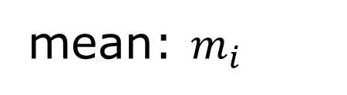







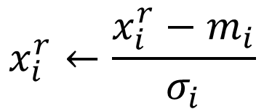

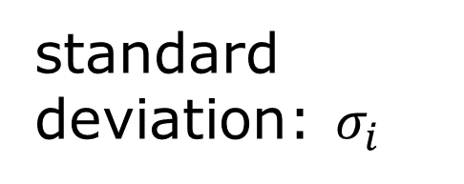

Feature Scaling
$$x^{1}$$
$$x^{2}$$
$$x^{3}$$
$$x^{r}$$
$$x^{m}$$
For each dimension i:
$$x_{1}^{1}$$
$$x_{1}^{2}$$
$$x_{2}^{1}$$
$$x_{2}^{2}$$
……
……
mean: $m_{i}$
……
……
……
……
……
standard deviation: $σ_{i}$
$$x_{i}^{r}←\frac{x_{i}^{r}−m_{i}}{σ_{i}}$$
The means of all dimensions are 0, and the variances are all 1
In general, gradient descent converges much faster with feature scaling than without it.
Notes:
Can we demo this???????????????
https://standardfrancis.wordpress.com/2015/04/16/batch-normalization/

Slide 30



Internal Covariate Shift
The first guy tells the second guy, “go water the plants”, the second guy tells the third guy, “got water in your pants”, and so on until the last guy hears, “kite bang eat face monkey” or something totally wrong.
Let’s say that the problems are entirely systemic and due entirely to faulty red cups. Then, the situation is analogous to forward propagation
If can get new cups to fix the problem by trial and error, it would help to have a consistent way of passing messages in a more controlled and standardized (“normalized”) way. e.g: Same volume, same language, etc
“First layer parameters change and so the distribution of the input to your second layer changes”

Slide 31


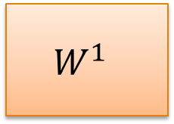




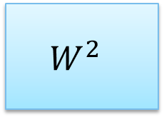



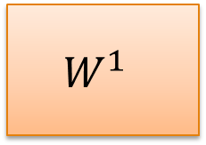




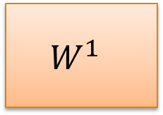





Batch
$$x^{1}$$
$$W^{1}$$
$$z^{1}$$
Sigmoid
$$a^{1}$$
$$W^{2}$$
……
$$x^{2}$$
$$W^{1}$$
$$z^{2}$$
Sigmoid
$$a^{2}$$
$$W^{2}$$
……
$$x^{3}$$
$$W^{1}$$
$$z^{3}$$
Sigmoid
$$a^{3}$$
$$W^{2}$$
……
$$z^{1}$$
$$z^{2}$$
$$z^{3}$$
$$W^{1}$$
$$x^{1}$$
$$x^{2}$$
$$x^{3}$$
Batch
=
Notes:
上學期好多人做!
https://ntumlds.wordpress.com/2017/03/26/r05922005_rrrr/

Slide 32
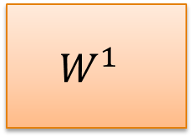




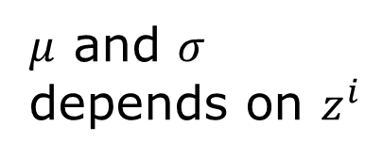







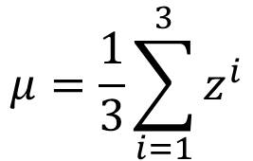
Batch normalization
$$x^{1}$$
$$W^{1}$$
$$z^{1}$$
$$μ=\frac{1}{3}\sum_{i=1}^{3}{z^{i}}$$
$$x^{2}$$
$$W^{1}$$
$$z^{2}$$
$$σ=\sqrt{\frac{1}{3}\sum_{i=1}^{3}{{\left(z^{i}−μ\right)}^{2}}}$$
$$x^{3}$$
$$W^{1}$$
$$z^{3}$$
$μ$ and $σ$ depends on $z^{i}$
$$μ$$
$$σ$$
Notes:
上學期好多人做!
https://ntumlds.wordpress.com/2017/03/26/r05922005_rrrr/

Slide 33
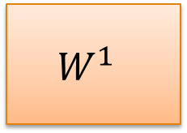












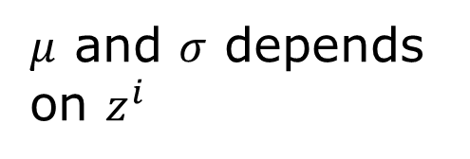




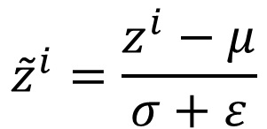
Batch normalization
$$x^{1}$$
$$W^{1}$$
$$z^{1}$$
$${\tilde{z}}^{1}$$
Sigmoid
$$a^{1}$$
$$x^{2}$$
$$W^{1}$$
$$z^{2}$$
$${\tilde{z}}^{2}$$
Sigmoid
$$a^{2}$$
$$x^{3}$$
$$W^{1}$$
$$z^{3}$$
$${\tilde{z}}^{3}$$
Sigmoid
$$a^{3}$$
$μ$ and $σ$ depends on $z^{i}$
$$μ$$
$$σ$$
$${\tilde{z}}^{i}=\frac{z^{i}−μ}{σ+ε}$$
Batch Norms happens between computing Z and computing A. And the intuition is that, instead of using the un-normalized value Z, you can use the normalized value Z
Notes:
上學期好多人做!
https://ntumlds.wordpress.com/2017/03/26/r05922005_rrrr/

Slide 34
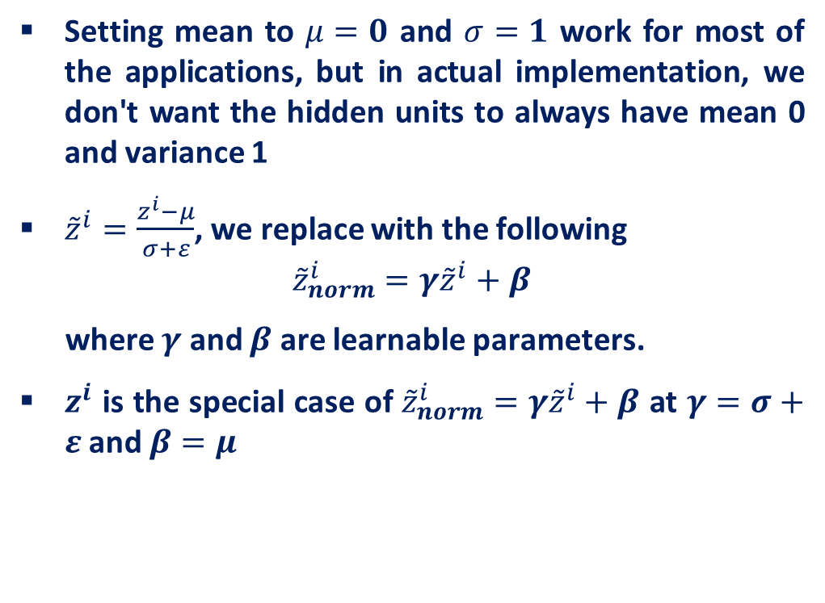
Batch normalization
Setting mean to $μ=0$ and $σ=1$ work for most of the applications, but in actual implementation, we don't want the hidden units to always have mean 0 and variance 1
${\tilde{z}}^{i}=\frac{z^{i}−μ}{σ+ε}$, we replace with the following
$${\tilde{z}}_{norm}^{i}=γ{\tilde{z}}^{i}+β$$
where $γ$ and $β$ are learnable parameters.
$z^{i}$ is the special case of ${\tilde{z}}_{norm}^{i}=γ{\tilde{z}}^{i}+β$ at $γ=σ+ε$ and $β=μ$

Slide 35

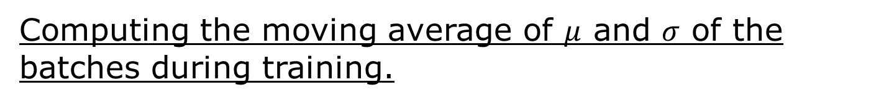




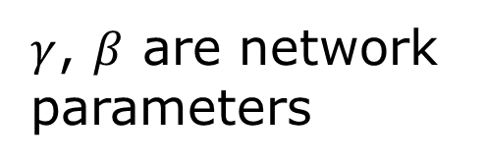


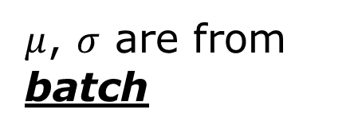

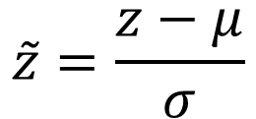

Batch normalization at testing time
Acc
$$μ_{300}$$
$$μ_{100}$$
$$μ_{1}$$
Updates
$$\tilde{z}=\frac{z−μ}{σ}$$
$$\tilde{z}$$
$${\hat{z}}^{i}=γ⨀{\tilde{z}}^{i}+β$$
$$\hat{z}$$
$$x$$
$$W^{1}$$
$$z$$
$μ$, $σ$ are from batch
$γ$, $β$ are network parameters
We do not have batch at testing stage.
Ideal solution:
Computing $μ$ and $σ$ using the whole training dataset.
Practical solution:
Computing the moving average of $μ$ and $σ$ of the batches during training.
Notes:
上學期好多人做!
https://ntumlds.wordpress.com/2017/03/26/r05922005_rrrr/

Slide 36
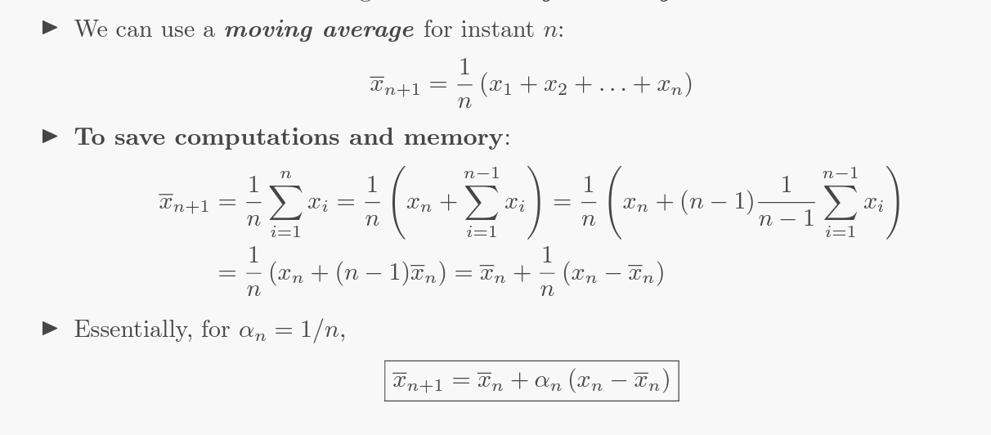
Moving Average

Slide 37

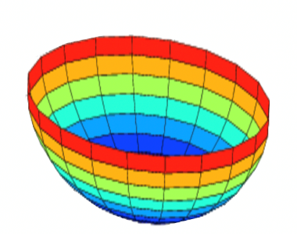






Why does normalizing the data make the algorithm faster?
Unnormalized:
In the case of unnormalized data, the scale of features will vary. This will make the cost function asymmetric.
It will take longer to converge to the minimum because the parameters for larger-scale features will dominate the updates.
$$J$$
$$w$$
$$b$$
Whereas, in the case of normalized data, the scale will be the same and the cost function will also be symmetric.
This makes it is easier for the gradient descent algorithm to find the global minima more quickly. And this, in turn, makes the algorithm run much faster.
Normalized:
$$J$$
$$w$$
$$b$$
Image Source: https://www.analyticsvidhya.com/blog/2018/11/neural-networks-hyperparameter-tuning-regularization-deeplearning/

Slide 38


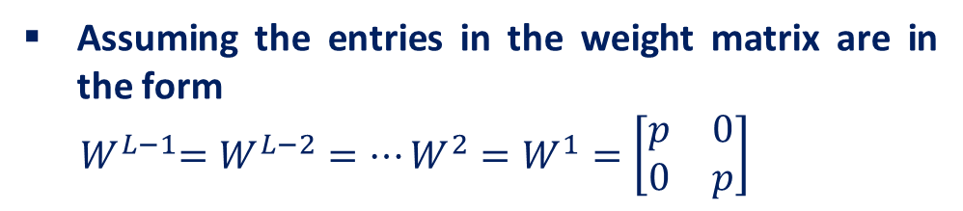

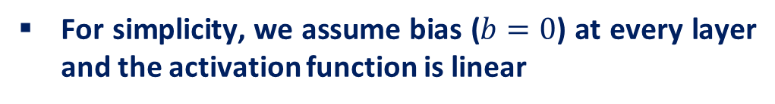








Vanishing / Exploding gradients
When you're training a very deep network, sometimes the derivatives can get either very small or very big, and this makes training difficult.
$$W^{1}$$
$$W^{2}$$
$$W^{L−1}$$
$$W^{L}$$
……
$$\overline{y}$$
……
$$Z^{1}=W^{1}x$$
$$Z^{2}=W^{2}Z^{1}$$
$$Z^{L−1}=W^{L−1}Z^{L−2}$$
$$\overline{y}=W^{L}Z^{L−1}$$
For simplicity, we assume bias ($b=0$) at every layer and the activation function is linear
$$\overline{y}=W^{L}W^{L−1}W^{L−2}…W^{2}W^{1}x$$
Assuming the entries in the weight matrix are in the form
$${ W}^{L−1}=W^{L−2}=…W^{2}=W^{1}=\left[\begin{matrix}p & 0 \\ 0 & p\end{matrix}\right]$$
$\overline{y}=W^{L}{×\left[\begin{matrix}p & 0 \\ 0 & p\end{matrix}\right]}^{L−1}×x$
then,
Source: https://www.coursera.org/learn/deep-neural-network/lecture/C9iQO/vanishing-exploding-gradients

Slide 39
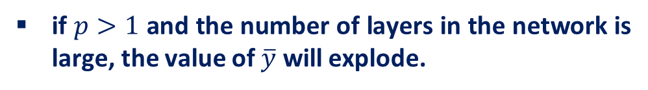


Vanishing / Exploding gradients
When you're training a very deep network, sometimes the derivatives can get either very small or very big, and this makes training difficult.
$$W^{1}$$
$$W^{2}$$
$$W^{L−1}$$
$$W^{L}$$
……
$$\overline{y}$$
……
$$Z^{1}=W^{1}x$$
$$Z^{2}=W^{2}Z^{1}$$
$$Z^{L−1}=W^{L−1}Z^{L−2}$$
$$\overline{y}=W^{L}Z^{L−1}$$
if $p>1$ and the number of layers in the network is large, the value of $\overline{y}$ will explode.
$$\overline{y}=W^{L}W^{L−1}W^{L−2}…W^{2}W^{1}x$$
Similarly, if $p<1$, the value of $\overline{y}$ will be very small. Hence, the gradient descent will take very tinny step.
$\overline{y}=W^{L}{×\left[\begin{matrix}p & 0 \\ 0 & p\end{matrix}\right]}^{L−1}×x$
Source: https://www.coursera.org/learn/deep-neural-network/lecture/C9iQO/vanishing-exploding-gradients

Slide 40
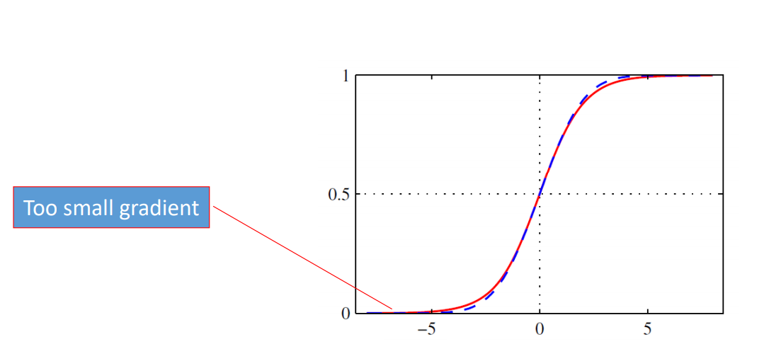
Solutions: Vanishing / Exploding gradients
Use a good initialization
Random Initialization
The primary reason behind initializing the weights randomly is to break symmetry.
We want to make sure that different hidden units learn different patterns.
Do not use sigmoid for deep networks
Problem: saturation
Sigmoid tends to saturate for very large positive or negative inputs, leading to the vanishing gradient problem, especially in deep networks.
Image Source: Pattern Recognition and Machine Learning, Bishop

Slide 41





ReLU
Rectified Linear Unit (ReLU)
Reason:
$$a$$
$$σ\left(z\right)$$
Fast to compute
No complex operations like exponentials, like sigmoid or tanh functions.
$$a=z$$
$$a=0$$
$$z$$
2. Vanishing gradient
problem
Notes:
Parametric ReLU, -> PReLU
Ref: Glorot, Xavier, Antoine Bordes, and Yoshua Bengio. "Deep sparse rectifier neural networks." International Conference on Artificial Intelligence and Statistics. 2011.
No differentailalbe how about 0
Benefit:
2011
Where does it come from?
fast to compute
biology?
many sigmoid

Slide 42




ReLU
$$a$$
$$a=z$$
$$a=0$$
$$z$$
0
0
0
0

Slide 43
ReLU
$$a$$
$$a=z$$
A Thinner linear network
$$a=0$$
$$z$$
Do not have smaller gradients

Slide 44











ReLU - variant
This helps to avoid the “dying ReLU” problem with the standard ReLU function, where a neuron with a negative bias may never activate and become “dead.”
$$Leaky ReLU$$
$$Parametric ReLU$$
$$a$$
$$a$$
$$a=z$$
$$a=z$$
$$z$$
$$z$$
$$a=0.01z$$
$$a=αz$$
$α$ also learned by gradient descent

Slide 45
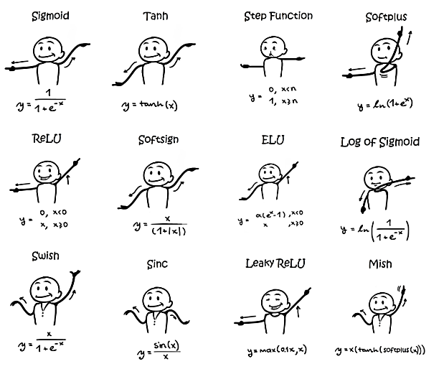
Activation Functions
Image Source: https://sefiks.com/2020/02/02/dance-moves-of-deep-learning-activation-functions/

Slide 46
Optimization Algorithms

Slide 47
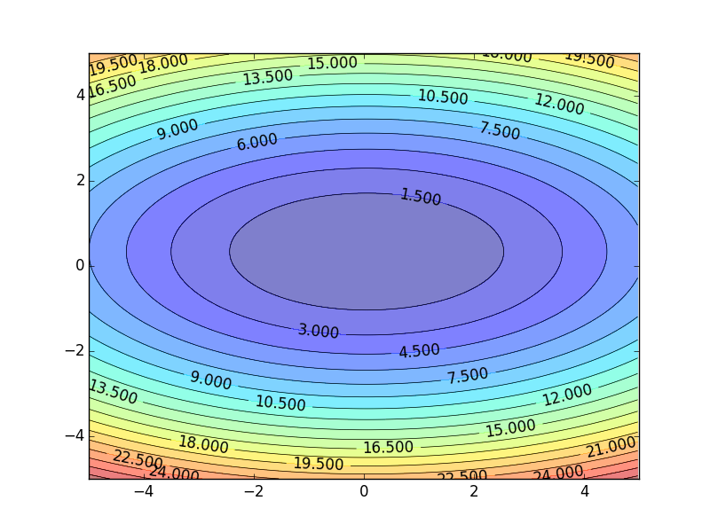

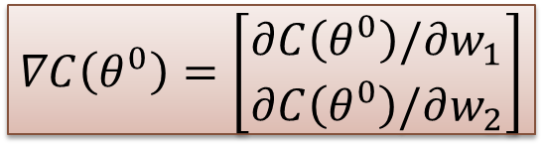
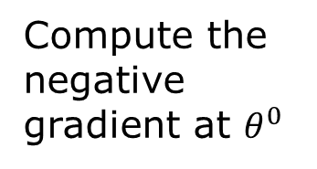


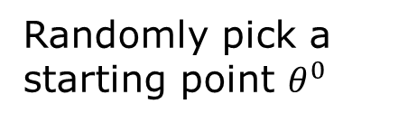
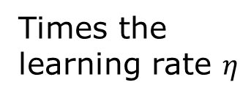






Gradient Descent
Assume there are only two parameters w₁ and w₂ in a network.
Error Surface
$$θ=\left\{w_{1},w_{2}\right\}$$
The colors represent the value of C.
Randomly pick a starting point $θ^{0}$
Compute the negative gradient at $θ^{0}$
$$w_{2}$$
$$θ^{∗}$$
$$−η∇C\left(θ^{0}\right)$$
$$−∇C\left(θ^{0}\right)$$
$$−∇C\left(θ^{0}\right)$$
Times the learning rate $η$
$$∇C\left(θ^{0}\right)=\left[\begin{matrix}∂C\left(θ^{0}\right)/∂w_{1} \\ ∂C\left(θ^{0}\right)/∂w_{2}\end{matrix}\right]$$
$$θ^{0}$$
$$−η∇C\left(θ^{0}\right)$$
$$w_{1}$$
Notes:
Eta
人站在 ｔｈｅｔａ０ 環顧四周 看看哪裡最低，那個方向就是 ｇｒａｄｉｅｎｔ

Slide 48


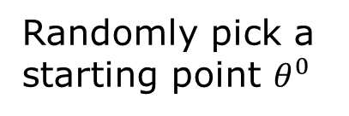

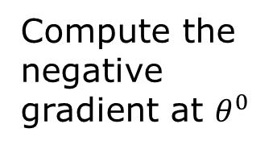



Gradient Descent
Eventually, we would reach a minima …..
Randomly pick a starting point $θ^{0}$
Compute the negative gradient at $θ^{0}$
$$θ^{2}$$
$$−η∇C\left(θ^{2}\right)$$
$$−η∇C\left(θ^{1}\right)$$
$$w_{2}$$
$$−∇C\left(θ^{2}\right)$$
$$−∇C\left(θ^{1}\right)$$
$$θ^{1}$$
$$−∇C\left(θ^{0}\right)$$
Times the learning rate $η$
$$θ^{0}$$
$$−η∇C\left(θ^{0}\right)$$
$$w_{1}$$

Slide 49





Gradient Descent
Gradient descent
Pros
Guaranteed to converge to global minimum for convex error surface
Converge to local minimum for non-convex error surface
Cons
Very slow
Intractable for dataset that do not fit in the memory
Different initial point $θ^{0}$
$$C$$
Reach different minima, so different results (non-convex)
$$w_{1}$$
$$w_{2}$$

Slide 50


Gradient Descent: Practical Issues

Slide 51

















Mini-batch
Randomly initialize $θ^{0}$
x¹
NN
y¹
Pick the 1st batch
$${\hat{y}}^{1}$$
Mini-batch
$$L^{1}$$
$$C=L^{1}+L^{31}+⋯$$
x³¹
NN
y³¹
$${\hat{y}}^{31}$$
$$θ^{1}←θ^{0}−η∇C\left(θ^{0}\right)$$
$$L^{31}$$
Pick the 2nd batch
……
$$C=L^{2}+L^{16}+⋯$$
NN
$$θ^{2}←θ^{1}−η∇C\left(θ^{1}\right)$$
x²
y²
$${\hat{y}}^{2}$$
Mini-batch
$$L^{2}$$
…
C is different each time when we update parameters!
x¹⁶
NN
y¹⁶
$${\hat{y}}^{16}$$
$$L^{16}$$
……
Notes:
Each time we update paramters, we have different target -> 不安
Shuffle data, and repeat above process

Slide 52







Mini-batch
Faster
Better!
Randomly initialize $θ^{0}$
x¹
NN
y¹
Pick the 1st batch
$${\hat{y}}^{1}$$
Mini-batch
$$C^{1}$$
$$C=C^{1}+C^{31}+⋯$$
x³¹
NN
y³¹
$${\hat{y}}^{31}$$
$$θ^{1}←θ^{0}−η∇C\left(θ^{0}\right)$$
$$C^{31}$$
Pick the 2nd batch
……
$$C=C^{2}+C^{16}+⋯$$
NN
$$θ^{2}←θ^{1}−η∇C\left(θ^{1}\right)$$
x²
y²
$${\hat{y}}^{2}$$
$$C^{2}$$
…
Mini-batch
Until all mini-batches have been picked
x¹⁶
NN
y¹⁶
$${\hat{y}}^{16}$$
$$C^{16}$$
one epoch
……
Repeat the above process
Notes:
Ｉｎ ｏｐｅｎ ｅｐｏｃｈ， ｕｐｄａｔｅ ｍａｎｙ ｔｉｍｅｓ
Shuffle data, and repeat above process

Slide 53


How can we choose a mini-batch size?
If the mini-batch size = m
It is a batch gradient descent where all the training examples are used in each iteration. It takes too much time per iteration.
If the mini-batch size = 1
It is called stochastic gradient descent, where each training example is its own mini-batch.
Since in every iteration we are taking just a single example, it can become extremely noisy and takes much more time to reach the global minima.
If the mini-batch size is between 1 to m
It is mini-batch gradient descent. The size of the mini-batch should not be too large or too small.
Source: https://www.coursera.org/learn/deep-neural-network/lecture/qcogH/mini-batch-gradient-descent

Slide 54
Learning Rate
Set the learning rate η carefully
$$−η∇C\left(θ^{0}\right)$$
If learning rate is too large
Cost may not decrease after each update
$$w_{2}$$
$$−∇C\left(θ^{0}\right)$$
$$θ^{0}$$
$$w_{1}$$

Slide 55
Learning Rate
Set the learning rate η carefully
Can we give different parameters different learning rates?
If learning rate is too large
Cost may not decrease after each update
$$w_{2}$$
If learning rate is too small
$$−∇C\left(θ^{0}\right)$$
$$−η∇C\left(θ^{0}\right)$$
$$θ^{0}$$
Training would be too slow
$$w_{1}$$

Slide 56




Adagrad
Divide the learning rate by “average” gradient
High-dimensional non-convex nature of neural networks optimization could lead to different sensitivity on each dimension.
The learning rate could be too small in some dimension and could be too large in another dimension.
$$w^{t+1}←w^{t}−\frac{η}{σ}g^{t}$$
$σ$: Average gradient of parameter w
Estimated while updating the parameters
If $w$ has small average gradient $σ$
Larger learning rate
If $w$ has large average gradient $σ$
Smaller learning rate

Slide 57
Adagrad
$$w^{1}←w^{0}−\frac{η}{σ^{0}}g^{0}$$
$$σ^{0}=g^{0}$$
$$σ^{1}=\sqrt{\frac{1}{2}\left[{\left(g^{0}\right)}^{2}+{\left(g^{1}\right)}^{2}\right]}$$
$$w^{2}←w^{1}−\frac{η}{σ^{1}}g^{1}$$
$$σ^{2}=\sqrt{\frac{1}{3}\left[{\left(g^{0}\right)}^{2}+{\left(g^{1}\right)}^{2}+{\left(g^{2}\right)}^{2}\right]}$$
$$w^{3}←w^{2}−\frac{η}{σ^{2}}g^{2}$$
$$……$$
$$σ^{t}=\sqrt{\frac{1}{t+1}\sum_{i=0}^{t}{{\left(g^{i}\right)}^{2}}}$$
$$w^{t+1}←w^{t}−\frac{η}{σ^{t}}g^{t}$$
Notes:
Why square

Slide 58





Adagrad
Divide the learning rate by “average” gradient
The “average” gradient is obtained while updating the parameters
$$σ^{t}=\sqrt{\frac{1}{t+1}\sum_{i=0}^{t}{{\left(g^{i}\right)}^{2}}}$$
$$η_{t}$$
$$w^{t+1}←w^{t}−\frac{η}{σ^{t}}g^{t}$$
$$η_{t}=\frac{η}{\sqrt{t+1}}$$
$$w^{t+1}←w^{t}−\frac{η}{\sqrt{\sum_{i=0}^{t}{{\left(g^{i}\right)}^{2}}}}g^{t}$$
1/t decay

Slide 59
Adagrad
Original Gradient Descent
$$θ^{t}←θ^{t−1}−η∇C\left(θ^{t−1}\right)$$
Each parameter w are considered separately
$$g^{t}=\frac{∂C\left(θ^{t}\right)}{∂w}$$
$$w^{t+1}←w^{t}−{\text{η}}_{w}g^{t}$$
Parameter dependent learning rate
constant
$${\text{η}}_{w}=\frac{η}{\sqrt{\sum_{i=0}^{t}{{\left(g^{i}\right)}^{2}}}}$$
Summation of the square of the previous derivatives

Slide 60
Acknowledgement
http://wavelab.uwaterloo.ca/wp-content/uploads/2017/04/Lecture_3.pdf
https://heartbeat.fritz.ai/deep-learning-best-practices-regularization-techniques-for-better-performance-of-neural-network-94f978a4e518
https://cedar.buffalo.edu/~srihari/CSE676/7.12%20Dropout.pdf
http://speech.ee.ntu.edu.tw/~tlkagk/courses/ML_2017/Lecture/DNN%20tip.pptx
Accelerating Deep Network Training by Reducing Internal Covariate Shift, Jude W. Shavlik
http://speech.ee.ntu.edu.tw/~tlkagk/courses/MLDS_2018/Lecture/ForDeep.pptx
Deep Learning Tutorial. Prof. Hung-yi Lee, NTU.
On Predictive and Generative Deep Neural Architectures, Prof. Swagatam Das, ISICAL

